Slide 1
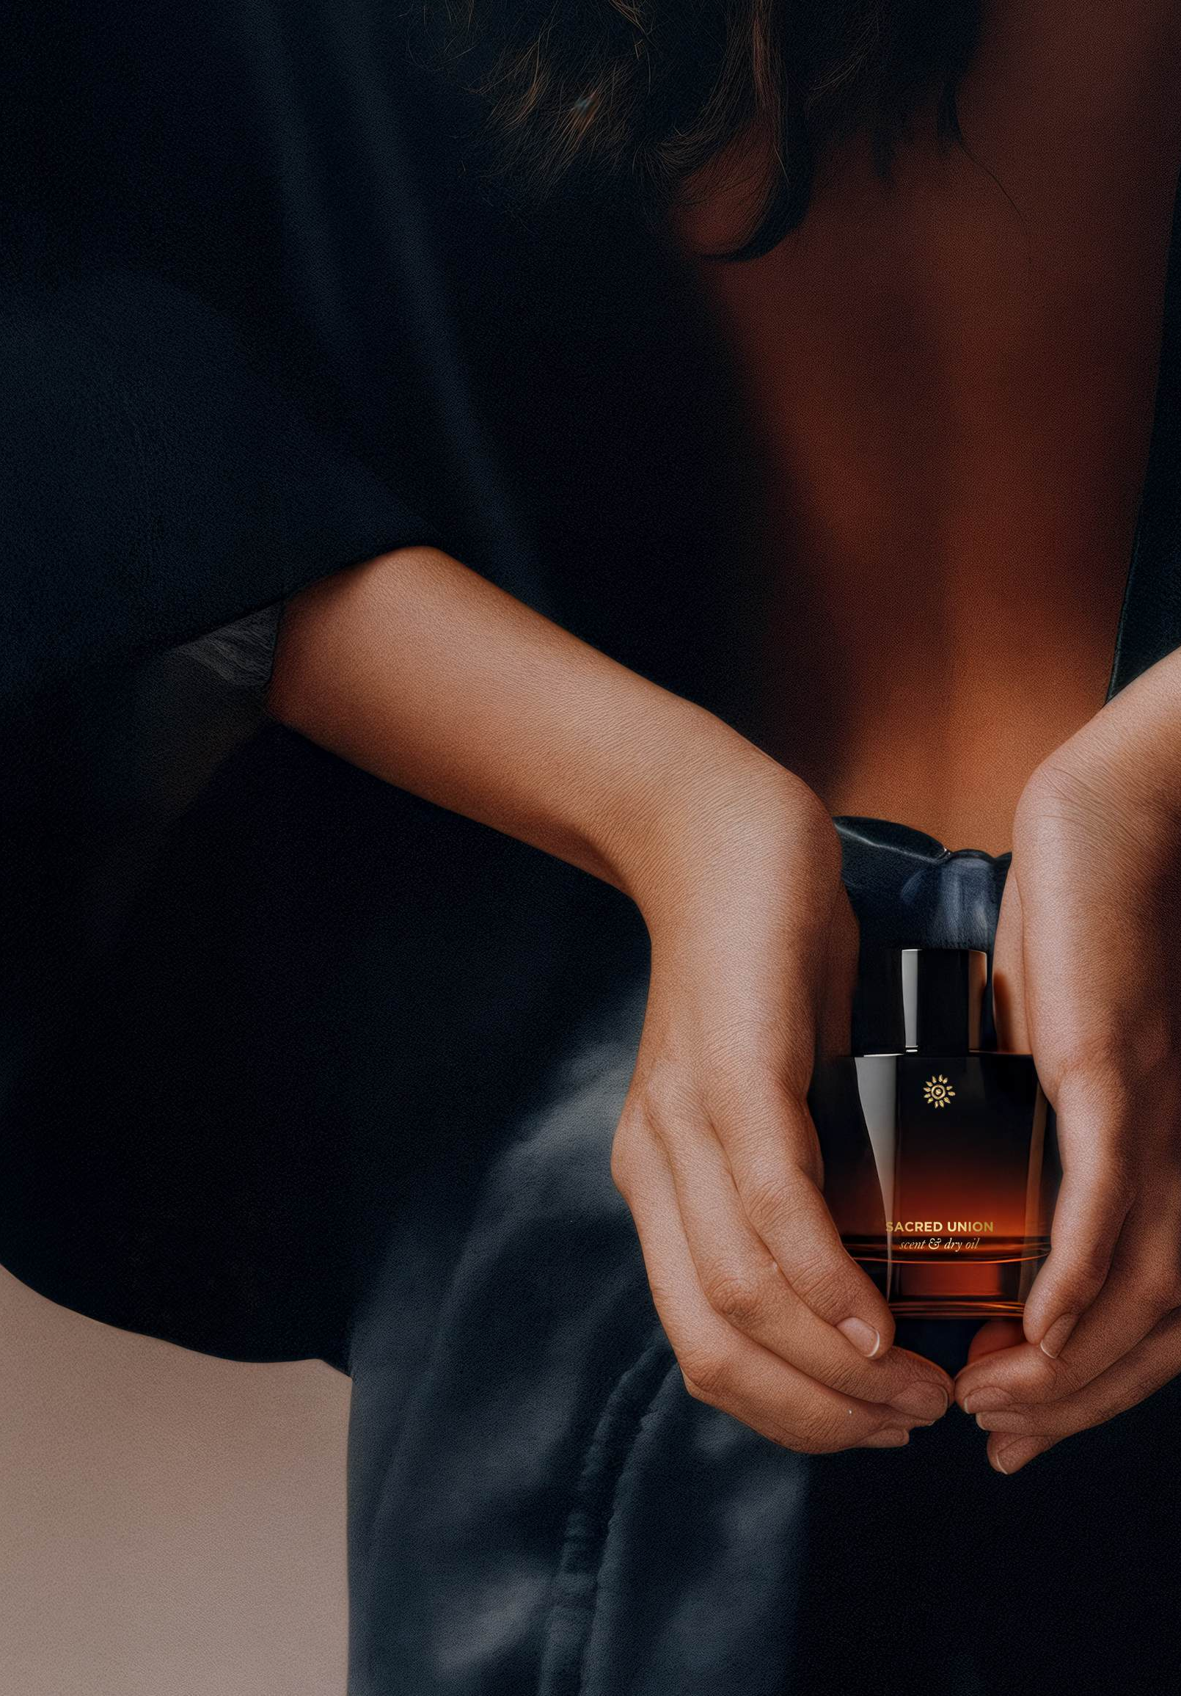
FUTURE OF COMMERCE · CLIENT CHALLENGE
Mauli Rituals
Integrating tech & emerging tech into retail a client challenge for the Future of Commerce course
Built from: a 42-minute client Q&A with founder Anita Kaushal (video)and the Mauli Retailer Deck, Aug 2026 (42 pp) · Classroom discussion deck
01 / 15

Slide 2
HOW TO USE THIS DECK
Five moves, one exit — a path, a workflow, and a new metric
01 Meet the client — 10 min — who they are, and the five things they refuse to compromise
02 Read the numbers — 10 min — the economics behind the romance: £87 AOV, 72% Meta, break-even
03 Her seven asks — 10 min — what the founder explicitly wants this class to solve
04 Choose a path & debate — 20 min — B2B, B2C, or one integrated workflow; defend your choice
05 Invent a metric — 15 min — a number that measures what actually makes this brand work
Exit test: every group can state the tension it would design against, the path it would take, and one new metric — in two minutes.
FUTURE OF COMMERCE · MAULI RITUALS CLIENT BRIEF
02 / 15

Slide 3
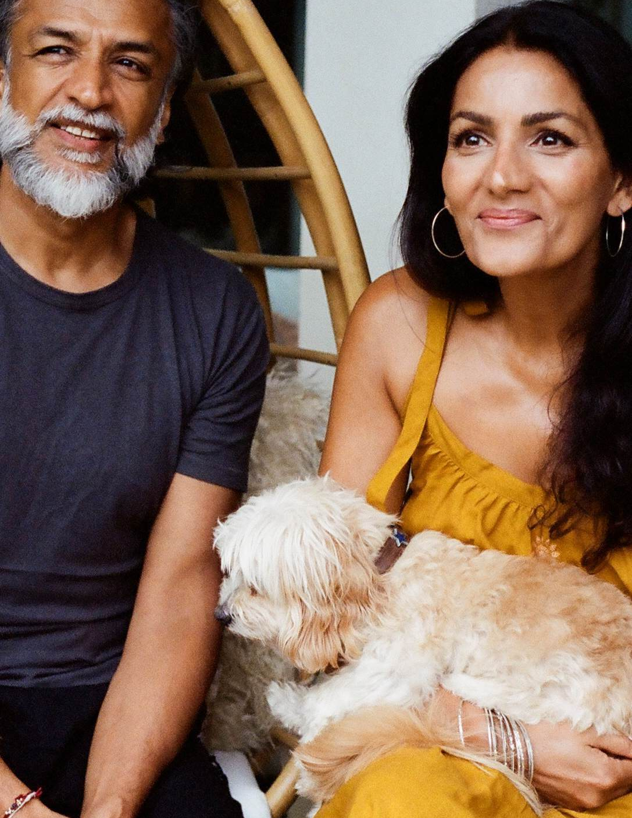
MOVE 01 · MEET THE CLIENT
An Ayurvedic luxury brand that Bulgari, Lamborghini and Range Rover came to
"Ancient wisdom + high-performance results + sensorial rituals" — Mauli distils Ayurveda into rituals for hair, skin, body and sleep. Made in England, from India's botanicals.
Founded — 2015, London, by Anita & Bittu Kaushal; heritage of Ayurvedic doctors, herbalists and plant-medicine farmers
"Authentic luxury" — natural, small-batch, sensorial; partners choose Mauli, not the reverse
Proof — 74 award wins, IP on formulations, 16 spa treatments (Aug 2026 deck)
Channels — D2C 61% of mix · destination spas · retail (Space NK) · hospitality amenities
Partners — Bulgari (9 yrs), Nobu, Four Seasons, One&Only, Stoke Park, Dishoom, Lamborghini, Range Rover, Emirates shortlist
Geography — UK home market; China via Xiaohongshu (RED); UAE via distributor; US deferred
Founders Anita & Bittu Kaushal — image from the client deck
FUTURE OF COMMERCE · MAULI RITUALS CLIENT BRIEF
03 / 15

Slide 4
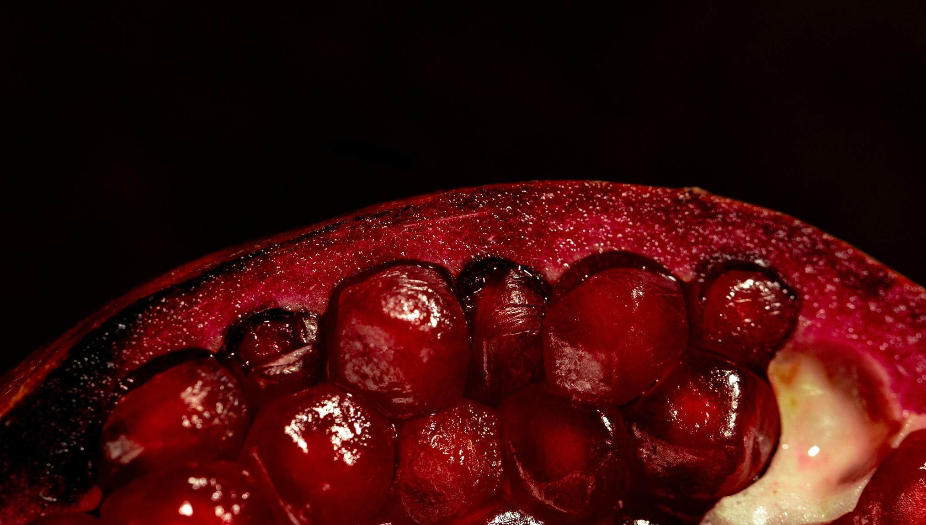
MOVE 01 · MEET THE CLIENT
The story any technology must not flatten
"In 2012, our daughter passed away from a brain tumor. Her dream was to help others feel connected and confident in living."
— Anita & Bittu Kaushal, "Our Story", client deck
THE FIVE NON-NEGOTIABLES
1 · Authentic luxury — natural, small-batch, made in England; no synthetic shortcuts
2 · Three pillars — look good, feel good, do good; ~5 products discontinued for not being best-in-class
3 · The red thread — every boxed product carries a blessed mauli made by an NGO in India
4 · No dilution — spas are refused cheaper formulas, even when it costs margin
5 · Give more than you take — the dosha quiz gives real self-care guidance with zero sales push
FUTURE OF COMMERCE · MAULI RITUALS CLIENT BRIEF
04 / 15

Slide 5
MOVE 02 · READ THE NUMBERS
The economics behind the romance, in six numbers
METRIC | VALUE | WHAT IT TELLS YOU
Average order value | £87 (often £100+) | Premium basket — but the brand "just about" breaks even on the first order
Marketing spend | 72% Meta / 28% Google | Heavy dependence on a channel the founder says is "becoming more and more challenging"
New vs returning | 46% / 54% | Retention-led model — community matters more than reach
Newsletter open rate | 77% | Value-first content (dosha guidance, no push) outperforms promotion
Instagram | 36k → 105k in 12 months | Outsourced, AI-assisted growth — "is she building the audience, or just the numbers?"
Sale events | 2 per year, −20% each | Revenue is skewed to sale windows; the brand wants out, gradually
Source — founder-stated figures, client Q&A video, Sep 2026
FUTURE OF COMMERCE · MAULI RITUALS CLIENT BRIEF
05 / 15

Slide 6
MOVE 02 · READ THE NUMBERS
Partnerships bring the halo; D2C brings thin profit
THE HALO — PARTNERSHIPS
THE ENGINE — D2C, 61% OF MIX
· Bulgari — nine years, bedrooms worldwide
· Lamborghini — from hand sanitiser to a scent for the cars
· Range Rover — found Mauli via a Google search, loved the story
· Emirates amenity shortlist; Stoke Park (Ambani family) asked Mauli to be spa partner
"Nice to have, but not that profitable… no compounding effect for profits."
· The profit engine of the business
· Barely breaks even on first order — discounting plus rising Meta costs
· AOV £87 has to carry acquisition, content, and fulfilment
· US expansion deferred; retail waits until it can be done properly
"We don't want to land and languish."
Retail reality: Space NK asks 65% margin + 10–15% marketing contribution + free product + paid placement — economics only large brands can swallow.
Discuss: if partnerships don't compound profit, what are they actually worth — and what would you do with them?
FUTURE OF COMMERCE · MAULI RITUALS CLIENT BRIEF
06 / 15

Slide 7
MOVE 02 · READ THE NUMBERS
A $10-trillion tailwind — but verify before you build on it
$6.8T → ~$9.8T
Global wellness economy, 2024 → 2029 — now larger than tourism, sports and the green economy
Sourcing caveat. The deck attributes these figures to "Global Wellness Summit '25" with no page or link; the Ayurveda CAGR has no stated source at all.
All deck figures are client-stated and unaudited — same standard as the founder's numbers on the call.
$24B → $85B+
Global Ayurveda market, 2026 → 2033 — ~19.7% CAGR, per the deck
Why now, per the deck: preventative wellbeing going mainstream · luxury hospitality embracing holistic wellness · ritual replacing routine · authenticity valued over marketing.
1 in 5
People globally will be over 60 by 2050 — spending shifts to longevity and quality of life
Team task: which one number would you verify first — and how would you verify it?
Source — Mauli Retailer Deck, Aug 2026
FUTURE OF COMMERCE · MAULI RITUALS CLIENT BRIEF
07 / 15

Slide 8
MOVE 03 · THE CUSTOMER
'Experimental traditionalists' — one audience, or two?
WHO THEY ARE — DECK PSYCHOGRAPHICS
THE TENSION — PER THE FOUNDER
· Enjoy exploring cultures and art
· Seek authentic luxury; eco-luxe with purpose
· Want results — and can afford to search for quality
· Need thrive-support for demanding schedules
· Want to learn and grow — Ayurvedic knowledge appeals
· Don't expect "youth in a bottle" — want efficacy, safety, formulas that work with their skin and age
· Core customer is 35+ — "maybe because I'm older, maybe because of the cost"
· Younger cohorts "absolutely loved the product" when reached
· TikTok deliberately untouched — "if we do it, we need to do it properly" (discounting culture, daily posting)
· Statistic she cited: older TikTok users shop on Saturday nights
· Entry products exist (£24–29 lip care) but young buyers "are not young, young like you generally"
Discuss: is "experimental traditionalists" one audience or two? Where would you reach them — without resorting to the discount-led tactics the brand is trying to escape?
FUTURE OF COMMERCE · MAULI RITUALS CLIENT BRIEF
08 / 15

Slide 9
MOVE 03 · THE BRIEF
Seven things the founder explicitly asked the class to solve
1 AI without losing the personal touch — translate the ritual and messaging with AI; her own agency "doesn't know how"
2 Personalization at scale — three dosha mind-body types, an on-site quiz, rich content; "where we would see it, that's for you to tell us"
3 Where to execute with limited resources — "where's the best place for us to execute and how — I'd love to learn from you"
4 Emerging tech for communication & retail — AR/VR, metaverse, AI to reach prospects who don't know the brand
5 New metrics — "the metrics we use in the next 10 years might just not work" — endorsed by the client
6 A therapist community platform — at-home therapists constantly ask to buy and treat; needs tiered automated purchasing, subscription, and vetting. "We will do it — it's a question of when"
7 Community over follower-counting — convert 105k Instagram followers into a genuine community
Per the instructor: teams may take a B2B path, a B2C path, or integrate all paths into one workflow — the mindset flip is from "how's the brand doing on social?" to "how do we automate and amplify the non-negotiables using tech?"
FUTURE OF COMMERCE · MAULI RITUALS CLIENT BRIEF
09 / 15

Slide 10
MOVE 04 · THE CORE FEAR
The question her own digital agency couldn't answer
"How does an AI shopping agent represent a multi-sensory ritual — without flattening it to a single SKU?"
Context: the brand already uses AI for Instagram content — the founder is ambivalent about it ("I don't always like the AI that we use, but it does really help"). The agency's uncertainty about ritual-and-AI is, verbatim, "what they wanted to know and what I'd love to know."
Sketch it: what would an "unflattened" AI ritual experience look like — for a first-time visitor who has never heard of Ayurveda?
FUTURE OF COMMERCE · MAULI RITUALS CLIENT BRIEF
10 / 15

Slide 11
MOVE 04 · OPPORTUNITY SPACES
Five tensions, five places to put the technology
THE TENSION | THE TECH ANGLE | THE QUESTION TO STRESS-TEST
AI vs. the personal touch | Dosha-personalised AI concierge — recommends rituals, not SKUs | Can a chatbot carry a ritual — and whose voice does it speak in?
A ritual can't be flattened | AR / VR sensorial retail; in-home ritual try-outs | What does "trying" a multi-sensory ritual digitally even mean?
Therapists keep knocking (B2B) | Tiered self-serve platform + subscription + AI vetting | How do you vet and tier thousands of practitioners at scale?
Numbers ≠ community | New community metrics beyond followers and opens | What evidence proves a community exists?
Halo without profit | Connected packaging bridging Bulgari / Emirates / Lamborghini touchpoints to D2C | Who owns the customer after the spa treatment ends?
Synthesis of the client Q&A + retailer deck — these are teaching framings, not client commitments.
FUTURE OF COMMERCE · MAULI RITUALS CLIENT BRIEF
11 / 15

Slide 12
MOVE 04 · CHOOSE YOUR PATH
B2B, B2C, or one workflow — the client's own framing
THE B2B PATH
THE B2C PATH
ONE WORKFLOW
You'd build
· Therapist community platform — tiers, subscription, vetting
· Retail enablement — staff training, dosha diagnostics in-store
Protect: vetting at scale; no diluted formulas; "we don't land and languish"
You'd build
· AI ritual concierge — dosha quiz → personalised rituals, not SKUs
· AR / VR sensorial experience for newcomers
· Community layer for the 105k followers
Protect: the personal touch; no discount-led growth
You'd build
· One journey: partnership touchpoint → QR → D2C community → subscription
Protect: coherence across five channels speaking to different audiences
The binding constraint — her words: "If we have limited resource, then where's the best place for us to execute and how is something I'd love to learn from you." Whatever you propose must say what you would not build.
FUTURE OF COMMERCE · MAULI RITUALS CLIENT BRIEF
12 / 15

Slide 13
MOVE 05 · DISCUSSION SET A — DEFEND A CHOICE
Four prompts — your group picks one and takes a position
Groups of 3–4 · 15 minutes · one prompt per group · 2-minute position to the room
1 Anita refuses to dilute formulas, even for spas. Is this principle a moat or a growth cap? Argue one side — with a number or an example.
2 She barely breaks even on first order but keeps a 77%-open newsletter. Where should the next marketing pound go: Meta, community, retail theatre — or somewhere with no precedent?
3 "Is she building the audience, or just the numbers?" — 105k followers, unknown community. What evidence would convince the founder her Instagram is a community?
4 Two −20% sale events anchor the revenue year. Design the exit: what replaces them, how fast, and what happens to revenue in year one?
Deliverable: one-sentence position + the non-negotiable it touches + the metric that would prove you right.
FUTURE OF COMMERCE · MAULI RITUALS CLIENT BRIEF
13 / 15

Slide 14
MOVE 05 · DISCUSSION SET B — INVENT THE METRIC
Propose a number the market hasn't seen yet
What describes ritual, community, and wellbeing?
THREE PASS CRITERIA
SEED EXAMPLES — STEAL OR REJECT
1 · Measurable with data a brand this size can actually collect
2 · Tied to a non-negotiable — it must move when the brand's values are honoured or diluted
3 · Future-proof — still meaningful in 10 years, on platforms that don't exist yet
· Ritual-completion rate — % of buyers who finish a 21-day ritual
· Feel-good ROI — self-reported wellbeing return per £ spent
· Therapist community health — activity, retention and referral inside the B2B network
Deliverable — one metric, fully specified: its name, its definition, how you would collect it, the decision it changes, and why a sceptical founder should trust it more than an open rate.
FUTURE OF COMMERCE · MAULI RITUALS CLIENT BRIEF
14 / 15

Slide 15

CLOSE · THE BRIEF, THE ASSETS, YOUR DELIVERABLE
Carry a ritual into the future without flattening it
A 10-year-old Ayurvedic luxury brand, sought out by Bulgari and Lamborghini, with almost no technology in its stack, asks: show how AI, AR/VR and emerging commerce can carry a multi-sensory ritual to new audiences — without flattening it into a SKU, without discount-led growth, without losing coherence across five channels — with new metrics that measure what actually makes the brand work. With limited resources. Tell us where to start.
WHAT LANDS ON YOUR DESK
· Brand deck — received (Aug 2026 retailer deck, 42 pp): positioning, market data, products, prices, B2B offer
· Product samples — hair oil and hero serum, to the class
· Competitor list (~8–9 brands): Aesop, Susanne Kaufmann, Ranavat, plus mass price benchmarks
· Direct founder access; deck contacts — Sales Adam · Marketing Erin · Orders Zehra · Ops Desi @ maulirituals.com
Your output to the client: one path, one workflow sketch, one new metric.
FUTURE OF COMMERCE · MAULI RITUALS CLIENT BRIEF
15 / 15
Notes:
Mauli doesn't have an awareness problem, and it doesn't really have a tech problem. It has an attention-cost problem wearing a tech costume:

